Slide 1
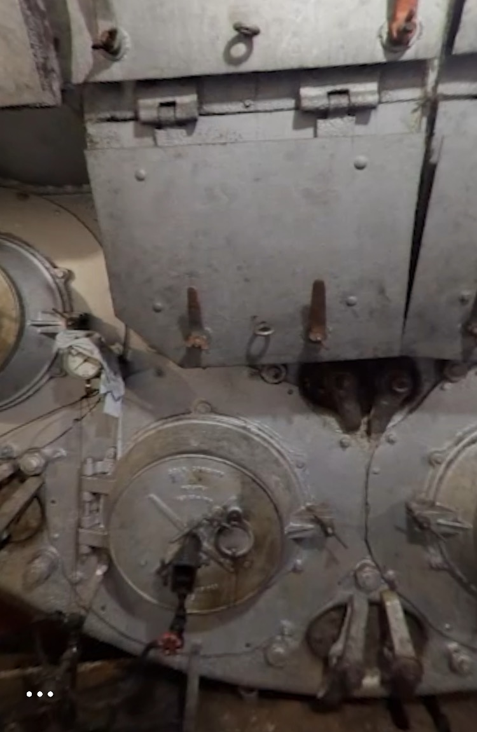
The Boiler Room
How is energy transferred in the boiler room?
________________________________________________________________________________________________________________________________________________________________________
________________________________________________________________________________________________________________________________________________________________________________________________________________________________
________________________________________________________
Notes:
See answer key from Day 4: Exit Ticket

Slide 2

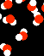
Steam Formula
Steam molecules have ______________energy.
When heat is applied to water, it becomes steam.
🔥+ =
Fire has __________
energy.
Notes:
See answer key from Day 4: Exit Ticket

Slide 3
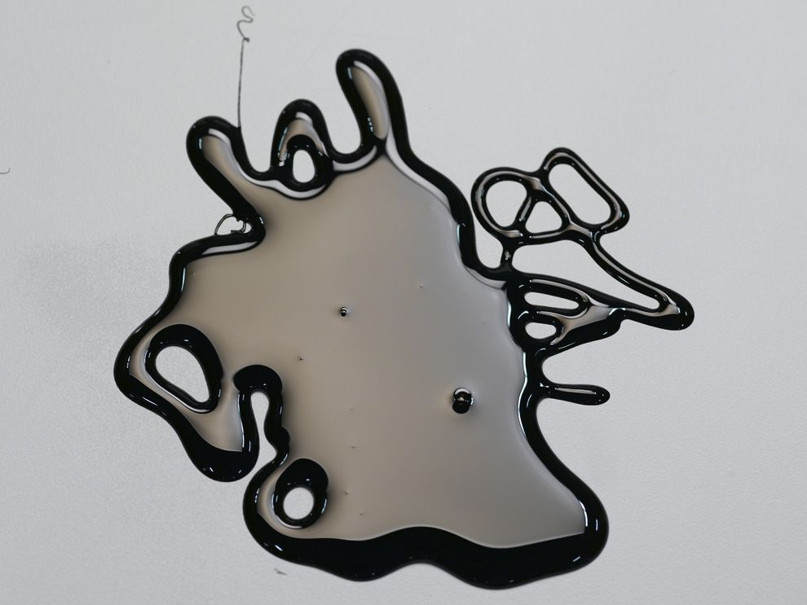
Fire Formula
When heat is applied to oil, it becomes fire.
Oil has ____________ energy.
+☀️ = 🔥
Fire has __________
energy.
oil
heat
fire
Notes:
See answer key from Day 4: Exit Ticket

Slide 4
What do you think it was like to work in the boiler room?

Slide 5

What is a historian?
A person who studies artifacts to learn more about the life during that time period.
Artifacts can be primary sources, or objects, letters, pictures, writing, etc. from that time period.
Artifacts can be secondary sources, or articles, books, pictures, etc. after that time period. Secondary sources often use primary sources for information. They summarize, analyze, or give opinions on the topic.

Slide 6
Your turn to be a historian...
Observe primary sources to learn more about working on Hercules in the boiler room.
Think:
  What was it like to be in the boiler room?
  What were some of the responsibilities of the people in the boiler room?
  What were positive parts of the job? Negative parts?
  Who worked there? Who DIDN’T work there?
Prove:
  How can you support your thinking using information from the primary sources?

Slide 7
Gallery Walk
You will have 4 minutes at each station to observe the primary source.
Think:
  What was it like to be in the boiler room?
  What were some of the responsibilities of the people in the boiler room?
  What were positive parts of the job? Negative parts?
  Who worked there? Who DIDN’T work there?
Prove:
  How can you support your thinking using information from the primary sources?
Sentence Frames:
  I am noticing that...I think this because…
  I think...because in the source…
  I agree/disagree with this idea because…
  I want to add on that...the proof is that...
Notes:
Gallery Walk: Print out materials. Create different stations around the room by placing one picture at each station. Students have 4 minutes at each station to think about the questions and respond on a post it note. As they rotate, they will leave their post it notes at that station.

Slide 8
Individual Reflection
Return to the stations to read about what your classmates wrote about each primary source. Think critically about their responses: Do you agree or disagree with them? Why?
When you are finished, go back to your seat and continue your individual reflection. What did you observe about the experience in the boiler room? What questions do you still have about it?

Slide 9
Class Reflection:
What did you observe about working in the boiler room? What is your proof?
Notes:
Examples: You have to pay very close attention to things in the boiler room because if not, a fire could start or smoke could happen (the proof is in the description from adventures of a farm boy), It was dark in the boiler room (the proof is in the pictures), etc.

Slide 10
Class Reflection #2:
What questions do you still have about the boiler room?

